Slide 1
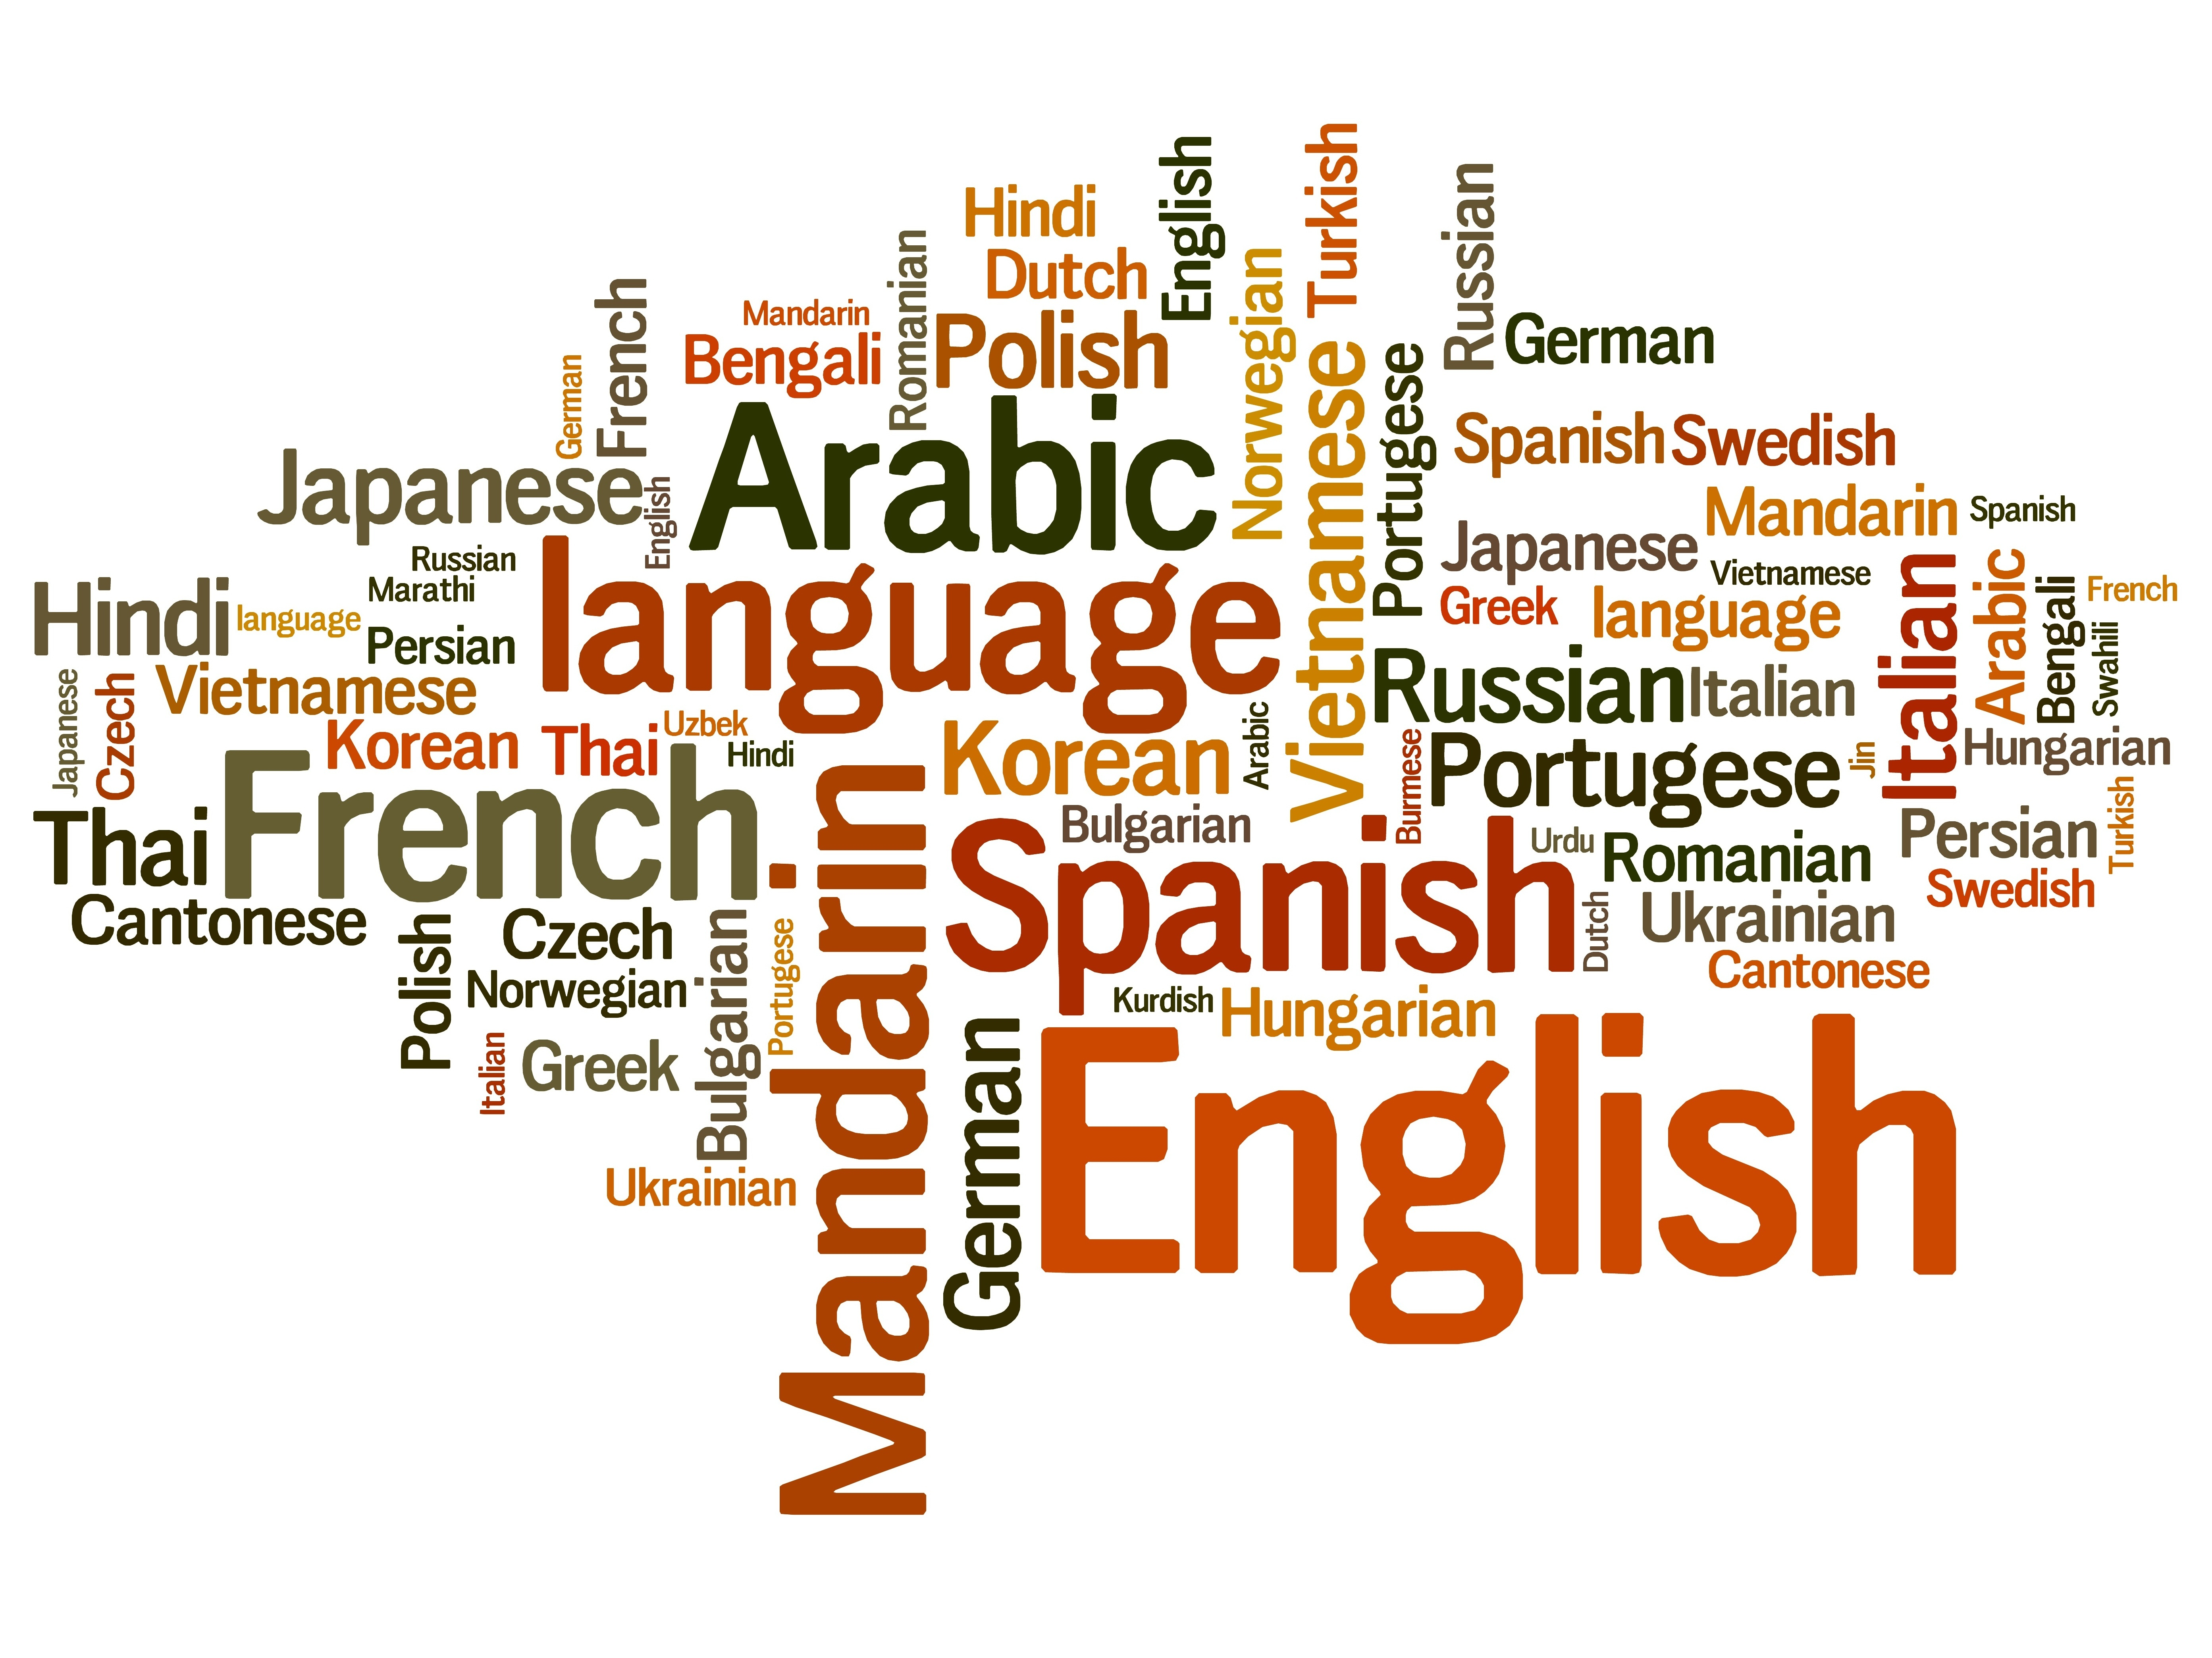
Dive Deeper into Present-Day English
Vol.4 -English Vocabulary 2(Pejoration and Amelioration)-
Composed By: Hayato Ishida
For Japanese version, click here
Updated On: 16 July 2024

Slide 2
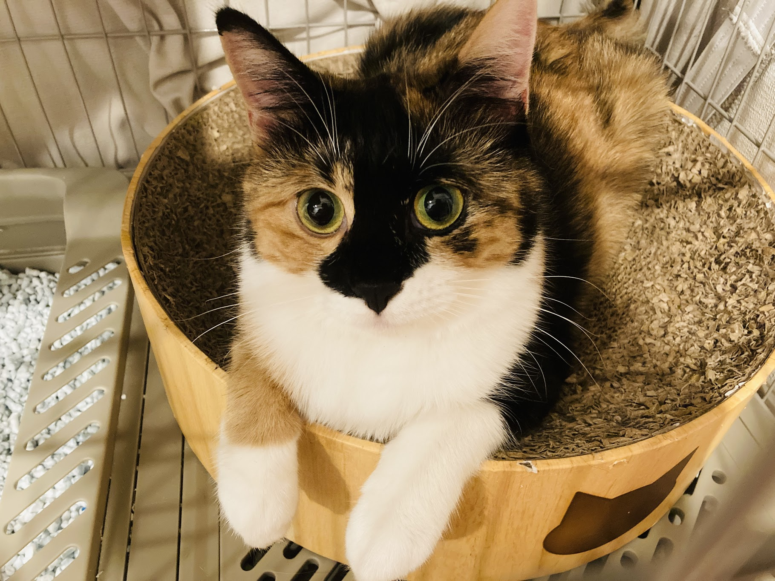
About Me
Accounts
GitHub: @hayat01sh1da
X: @hayat01sh1da
LinkedIn: @hayat01sh1da
Speaker Deck: @hayat01sh1da
Docswell: @hayat01sh1da
Occupation: Software Engineer
Things I Am Into
Linguistics
Singing at Karaoke
Listening to Music
Watching Movies
Cat Feeding

Slide 3
Licences / Certifications
English
TOEIC® Listening & Reading 915: Certified on December 2019
Engineering
Information Security Management: Certified on November 2017
Applied Information Technology Engineer: Certified on June 2017
Fundamental Information Technology Engineer: Certified on November 2016
IT Passport: Certified on April 2016
Others
Abacus 2nd Class: Certified on June 2002
Mental Arithmetic 3rd Class: Certified on February 2001

Slide 4
Skill Stack
Languages
Japanese: Native Proficiency
English: Full professional Proficiency
Development
Backend: Ruby(Ruby on Rails), Python
Frontend: TypeScript + React.js, TypeScript +Vue.js
Database: MySQL, PostgreSQL, MongoDB
Architecture: Monolith, Modular Monolith
Hosting: AWS ESK
Versioning: Git, GitHub
CI/CD: GitHub Actions, ArgoCD
Monitoring: Datadog, Sentry

Slide 5
Work Histories
Period | Genre | Position | Jobs
Aug 2021 - Present | Saas(Educational Service) | Software Engineer | Backend Development Frontend Development CI/CD Maintenance Weekly Release Manager Troubleshooting Documentation Technical Debt Resolution Tech Blog Entries LT Speaker
Feb 2020 - Dec 2020 | SaaS(Chatbot Platform) | Backend Engineer | Backend Development Documentation Technical Debt Resolution Inspection of Alternative API

Slide 6
Work Histories
Period | Genre | Position | Jobs
Jun 2018 - Jan 2020 | Contract-basis Developer | Software Engineer | Backend Development Frontend Development Troubleshooting Quality Assurance Tech Blog Entries
Apr 2016 - Jan 2018 | System Engineering Service | System Engineer | Corporate Account Admin Windows Server Maintenance Security Admin Assistant Internationalisation / Localisation

Slide 7
International-Exchange Activities
Activities in University
English Linguistics Seminar(Focusing on Mass Media English)
International-Exchange Clubs(The 2nd Year)
International-Exchange Programmes conducted by Japan Cabinet Office(2013 - 2016)
Japanese Linguistics Course(The Final Year)
Overseas Life Experience
Working Holiday in Australia(April 2014 - March 2015)
Language School for 1 month in Sydney
Work for 6 Months in Hamilton Island Resort
Volunteering for 1 Month as Assistant Teacher of Japanese Language at St Ives High School in NSW
Other Activities
Keep Everyday Journal in English (April 2014 - Present)
Sunrise Toastmasters Club(February 2017 - March 2018)
Vital Japan(January 2018 - July 2019, October 2022 - February 2023)
Self Learning and Training of English Language
Participation Ruby-Related Tech Conferences

Slide 8
Goals of This Series
To know how deep English Language is
Not simply a communication tool
To know your own language by knowing another
"He who knows no foreign languages knows nothing of his own." by Johann Wolfgang von Goethe
To pursue the essence that does not instantly but work later on
Something which you think is meaningless has something genuine

Slide 9
Agenda
Pejoration
Amelioration
Summary
References

Slide 10
1. Pejoration

Slide 11
1. Pejoration
English language has some words that are used as bad meanings which used to
originally as good ones in its vocabulary.
Linguistic change from a good meaning to bad one through a long English history is called Pejoration.
silly represents it according to Dictionary.com, so why do we not discuss the historical changes of its forms and meanings?

Slide 12
1. Pejoration
Some Definitions of silly on Dictionary.com
weak-minded or lacking good sense; stupid or foolish
absurd; ridiculous; irrational
[Archaic] rustic; plain; homely
[Archaic] weak; helpless
[Obsolete] lowly in rank or state; humble
Historical Changes of Word Forms of silly
Old English: gesǣlig as 'happy' and 'blessed'
The prefix -ge dropped and the suffix -ig became -ly observed all over English today as in juicy and dreamy etc.
sǣl meant 'happiness'
Early Middle English: sylie, sillie
Late Middle English: syly, variant of sely seely

Slide 13
1. Pejoration
Historical Changes in Word Meanings of silly
Periods | Meanings
Old English | happy, blessed
Early Middle English | holy, innocent, helpless
Mid Middle English | pitiable, insignificant; simple, ignorant
Late Middle English | lacking in good sense, foolish, irrational, ridiculous

Slide 14
1. Pejoration
Historical Changes in Word Meanings of silly in Depth
Something happy can be considered favoured by God.
Something favoured by God can be considered holy, and so innocent, which may be said of a small animal or child who is harmless or defenseless.
And if you cannot protect yourself or you lack power, you might be considered
worthless or miserable - and so silly apparently jumps to foolish.
Reference: Dictionary.com > Silly > MORE ABOUT SILLY > Dig Deeper

Slide 15
1. Pejoration
The Difference in Terms of Nuances compared with A Synonym
The precedent historical changes of word meanings makes a difference in terms of nuance, which leads to distinctions between synonyms.
A friend of mine often tells me, "You are stupid".
The friend of yours likely to strongly declare that you are really foolish.
A friend of mine often tells me, "You are silly".
The friend of yours feels like you are foolish with senses of pity and empathy to you.

Slide 16
1. Pejoration
Other Examples of Pejoration
Words | Origins | Present Meanings
knave | Old English: cnafa Middle English: First recorded before 1000 Cognate with Knabe('boy') and akin to knapi('page', 'boy') in Old Norse | an unprincipled, untrustworthy, or dishonest person.
villain | First recorded 1275 - 1325 Middle English: vilein Middle French: villain('churlish rustic', 'serf') Vulgar Latin and Medieval Latin: villānus('a farm servant', 'farmhand') | a cruelly malicious person
cunning | Old English: cunnung Middle English: First recorded in 1275 - 1325 as noun | skill employed in a shrewd or sly manner

Slide 17
2. Amelioration

Slide 18
2. Amelioration
English language has some words that are used as bad meanings which used to originally as good ones in its vocabulary.
Linguistic change from a good meaning to bad one through a long English history is called Amelioration.
nice represents it according to Dictionary.com, so why do we not discuss the
historical changes of its forms and meanings?

Slide 19
2. Amelioration
Some Definitions of nice on Dictionary.com
pleasing; agreeable; delightful
amiably pleasant; kind
[Obsolete] coy, shy, or reluctant
[Obsolete] unimportant; trivial
[Obsolete] wanton
Historical Changes of Word Forms of nice
nescius in Latin
Consists of a negative prefix ne- + sci-(stem of scīre meaning 'to know') + an adjective suffix -us

Slide 20
2. Amelioration
Historical Changes in Word Meanings of nice
First recorded in 1250 - 1300 in Middle English meaning 'foolish' and 'stupid'
silly and simple from French
ignorant and incapable from Latin
The transition below follows later on
wanton
fastidious, fussy
difficult to manage
minute and subtle
precise, critical
minutely accurately
pleasant, attractive

Slide 21
2. Amelioration
Historical Changes in Word Meanings of nice in Depth
Originally it referred to something foolish and stupid and then it came to mention something reckless.
Such things are difficult to manage, but they require someone to be sensitive and deal with things in a minutely accurate way.
It has changed into the present meaning pleasant and attractive.

Slide 22
2. Amelioration
Polysemy in the 16 - 17th Century during the Transition of Meanings
The same writer expressed something totally different with the same word.
nice and trivial
Richard 3, Act 3, Scene 7, Line 175, William Shakespeare
on the nice hazard of one doubtful hour
Henry 3, 4, Part 1, Act 4, Scene 1, Line 48, William Shakespeare

Slide 23
2. Amelioration
Other Examples of Amelioration
Words | Origins | Present Meanings
boy | Old English: A man's name Bōia Middle English: boy(e) - First recorded 1250 - 1300 Cognate with Frisian boi 'young man' Akin to Old English bōfa, Old Norse bōfi, Old High German Buobo a man's name(German Bube 'knave' - dialectal 'boy', 'lad') | a male child, from birth to full growth
fame | 1175 - 1225 Roots: Middle English < Anglo-French, Old French < Latin fāma of which meanings were talk, public opinion, repute; akin to fārī(to speak) | widespread reputation
pretty | Old English: prættig, prettī 'cunning', derivative of prǣtt 'trick', 'wile' Middle English: prati(e), pratte, prettie meaning 'cunning', 'gallant', 'fine', 'handsome', pretty' - First recorded before 1000 Cognate with Dutch part, pret 'trick', 'prank' and Old Norse prettr 'trick', prettugr 'tricky' | pleasing or attractive to the eye, as by delicacy or gracefulness

Slide 24
3. Summary

Slide 25
3. Summary
Pejoration is the historical changes of words from Good to Bad meanings.
Amelioration is the historical changes of words from Bad to Good meanings.
Survival of vocabulary requires words to have distinct meanings or nuances from those of synonyms.
To dig deeper the history of a word, you will find the answer.

Slide 26
4. References

Slide 27
4. References
Kiyoaki Kikuchi・Kazutomo Karasawa ・Takeshi Koike・ Ryuichi Hotta ・Kazuki Fukuda・ Yasuyuki Kaizuka ・Takeshi Matsuzaki, 英語学：現代英語をより深く知る ために-現代英語の諸相と英語学術語解説-, Osaka, 浪漫書房, 2008
Dictionary.com
Last Accessed On: 11 February 2024

Slide 28
EOD

